Slide 1
AIRCRAFT NATURE CONDITION PREDICTION
-KARTHI M

Slide 2
PROBLEM STATEMENT
The challenge lies in effectively leveraging Natural Language Processing (NLP) techniques to analyze textual descriptions of historical aircraft incidents and predict nature conditions affecting aircraft operations.
By doing so, we aim to address the need for proactive risk mitigation strategies in the aviation industry, enhancing safety and operational reliability by anticipating and preparing for potential nature-induced disruptions.

Slide 3
INTRODUCTION
Aviation safety relies on the proactive identification and mitigation of risks posed by nature-induced disruptions such as warning indications and other occurrences.
Leveraging Natural Language Processing (NLP) techniques, this study aims to analyze textual descriptions of historical aircraft incidents to develop predictive models for anticipating nature conditions.

Slide 4
DATASET
Source:Kaggle
Link: https://www.kaggle.com/datasets/tarique7/airline-incidents-safety-data
Dataset Size: 100028, 4

Slide 5
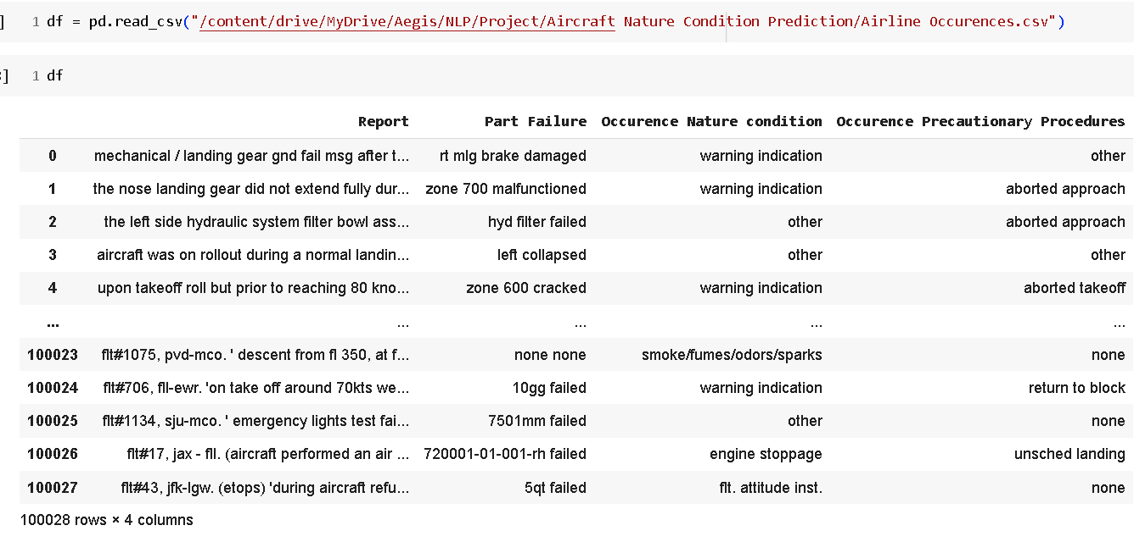
EXPLORATORY DATA ANALYSIS

Slide 6
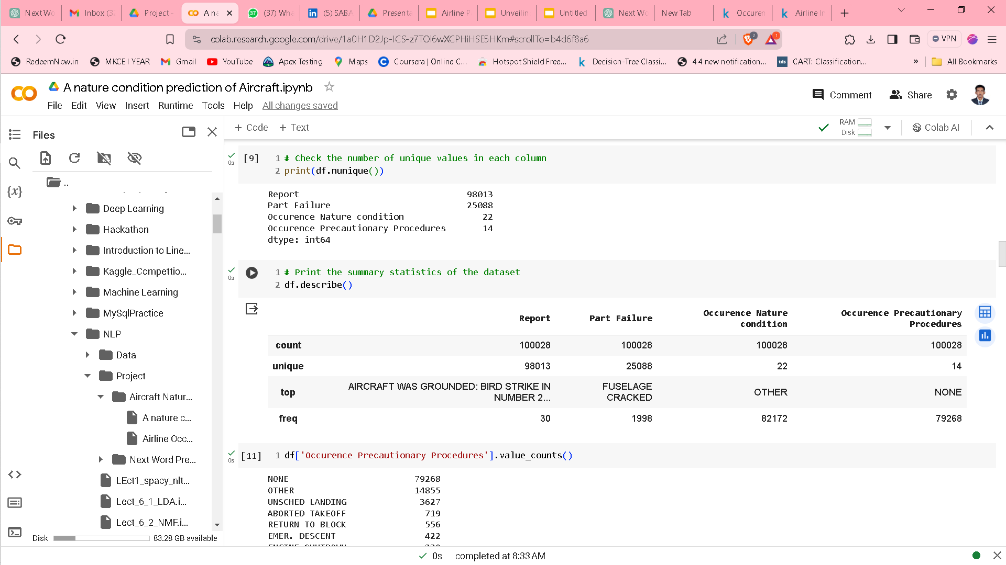
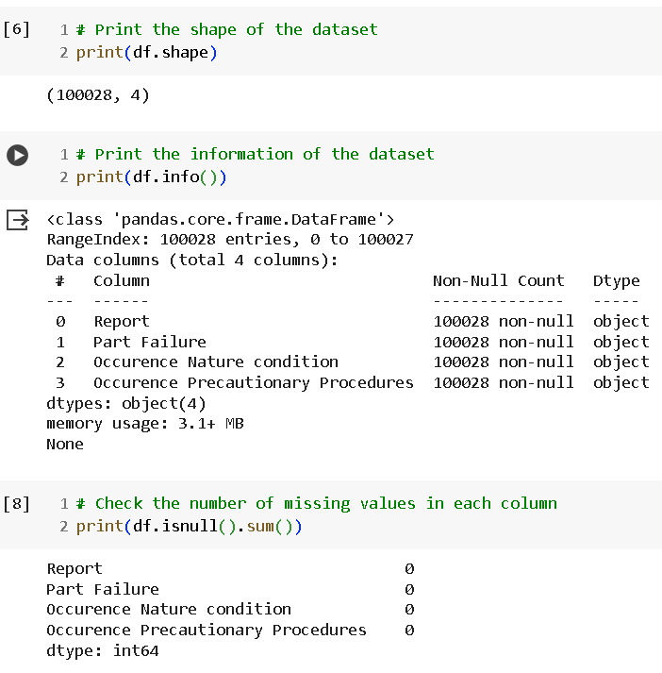
EXPLORATORY DATA ANALYSIS
Initial Statistics

Slide 7
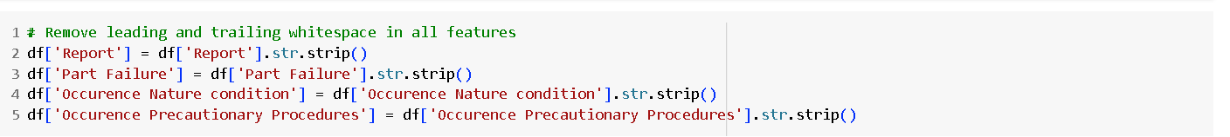
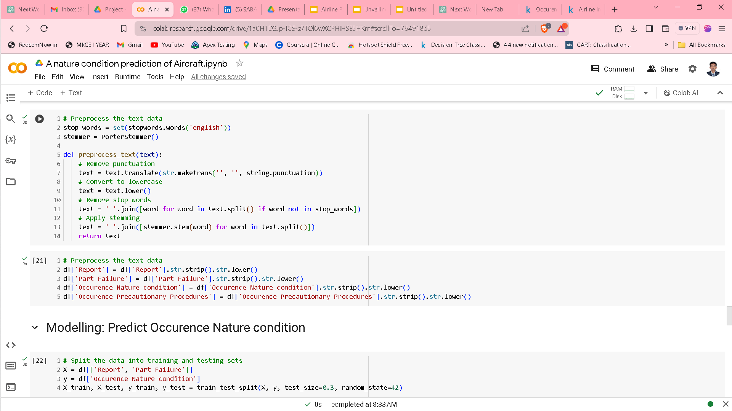
EXPLORATORY DATA ANALYSIS
Data Cleaning

Slide 8
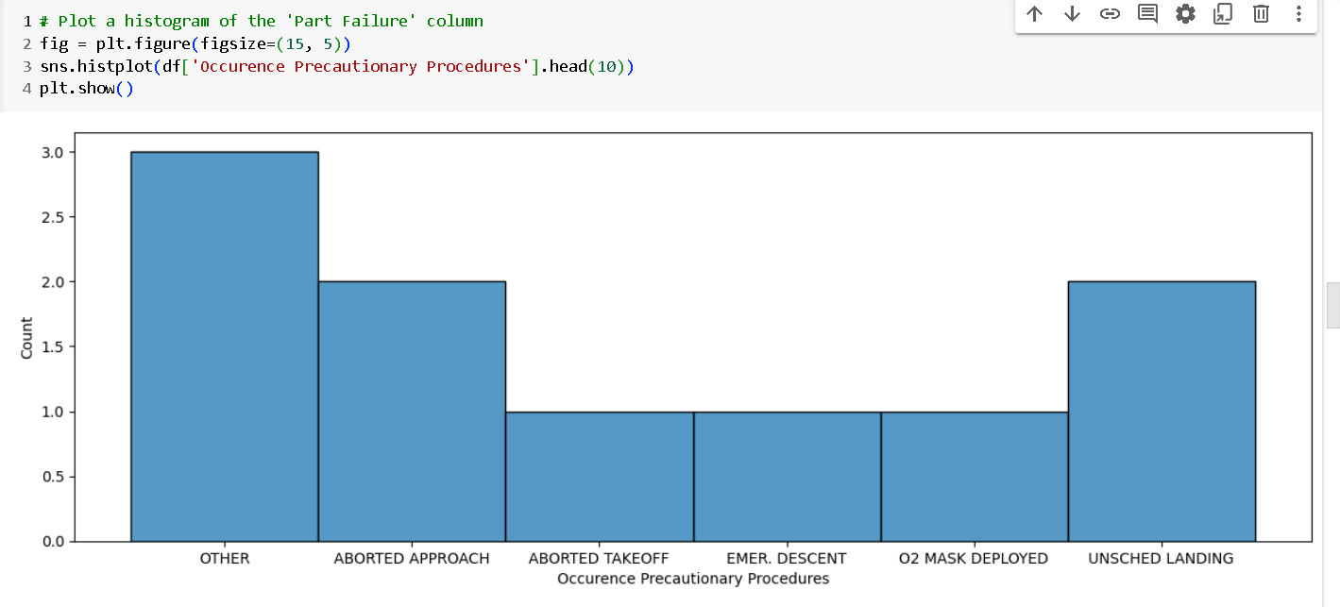
EXPLORATORY DATA ANALYSIS
Data Visualization

Slide 9
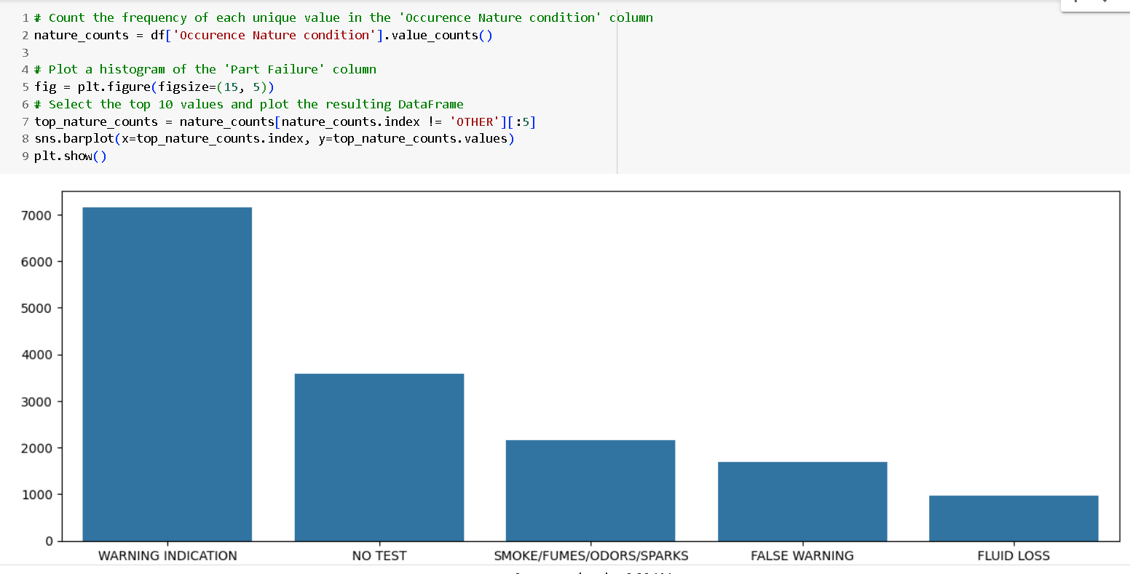
EXPLORATORY DATA ANALYSIS

Slide 10
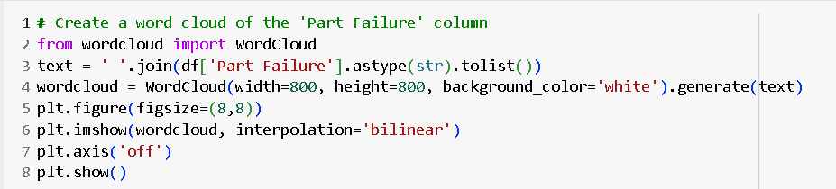
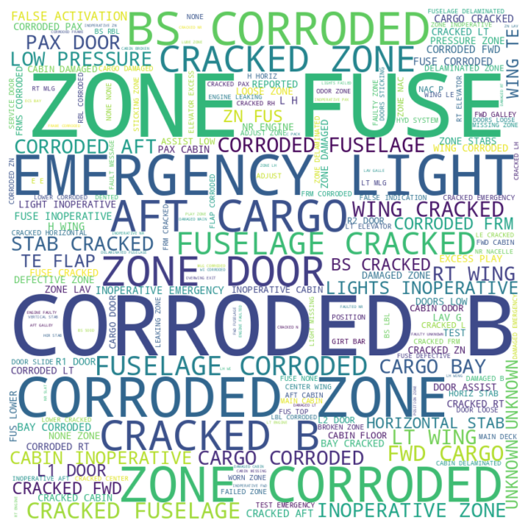
EXPLORATORY DATA ANALYSIS

Slide 11
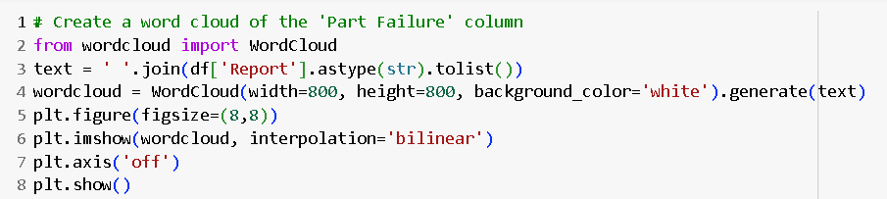
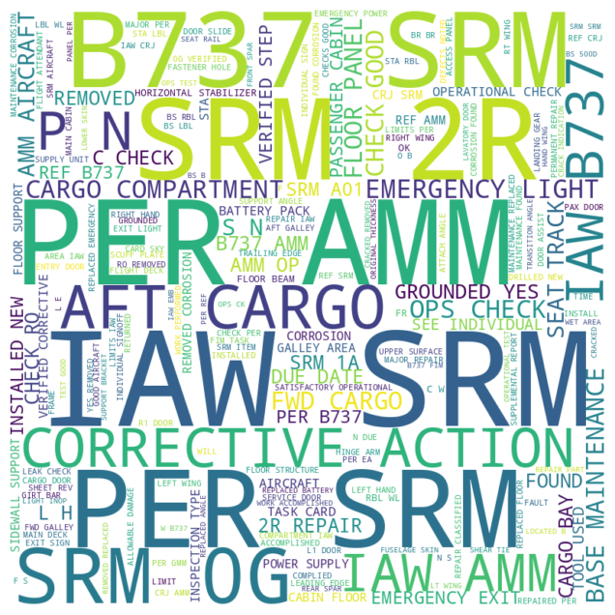
EXPLORATORY DATA ANALYSIS

Slide 12
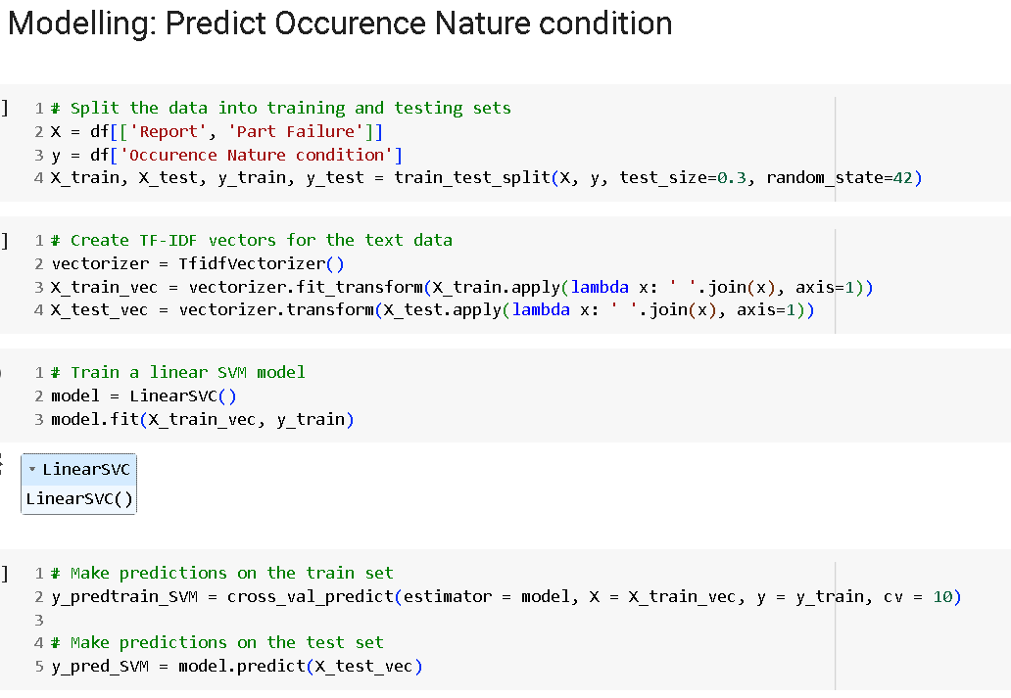
Modelling

Slide 13
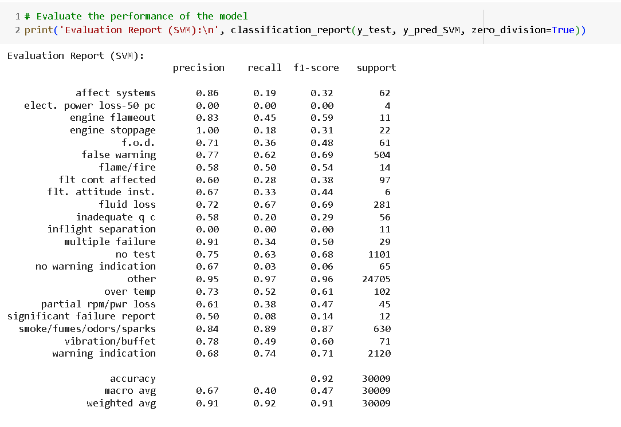
Model Evaluation

Slide 14
CONCLUSION
The achieved accuracy rate of 92% demonstrates the efficacy of our predictive model in anticipating nature conditions affecting aircraft operations, indicating its potential to enhance aviation safety through proactive risk management strategies.
With its high accuracy, our model holds promise for supporting informed decision-making and preemptive measures against nature-induced disruptions, thereby contributing significantly to the reliability and safety of aircraft operations in the aviation industry.

